Slide 1

Case study at Manhattan, New York
Selecting a neighborhood to open a new Japanese Restaurant

Slide 2
Business problem
I would like to open a Japanese Restaurant in Manhattan, New York but I don’t know which neighborhood to select.
It is not wise to open the restaurant in a neighborhood with restaurants that are highly appreciated.
It is also not wise to open the restaurant in a neighborhood with a lot of restaurants of the same category.

Slide 3
Data source
Manhattan Geospatial Data: 2014 New York City Neighborhood Names by New York (City), Department of City Planning. https://geo.nyu.edu/catalog/nyu_2451_34572
Foursquare API: https://developer.foursquare.com/

Slide 4
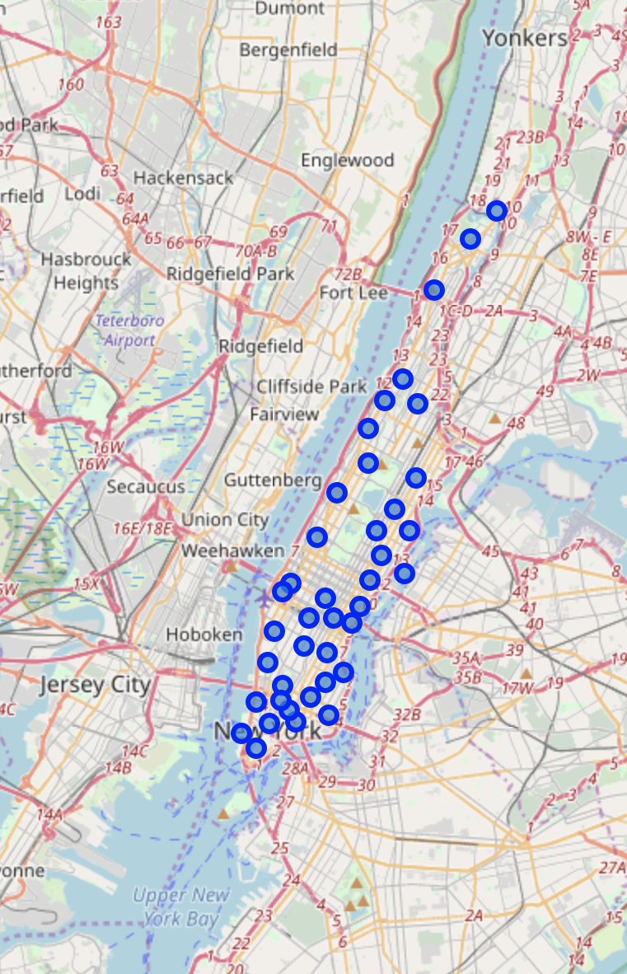
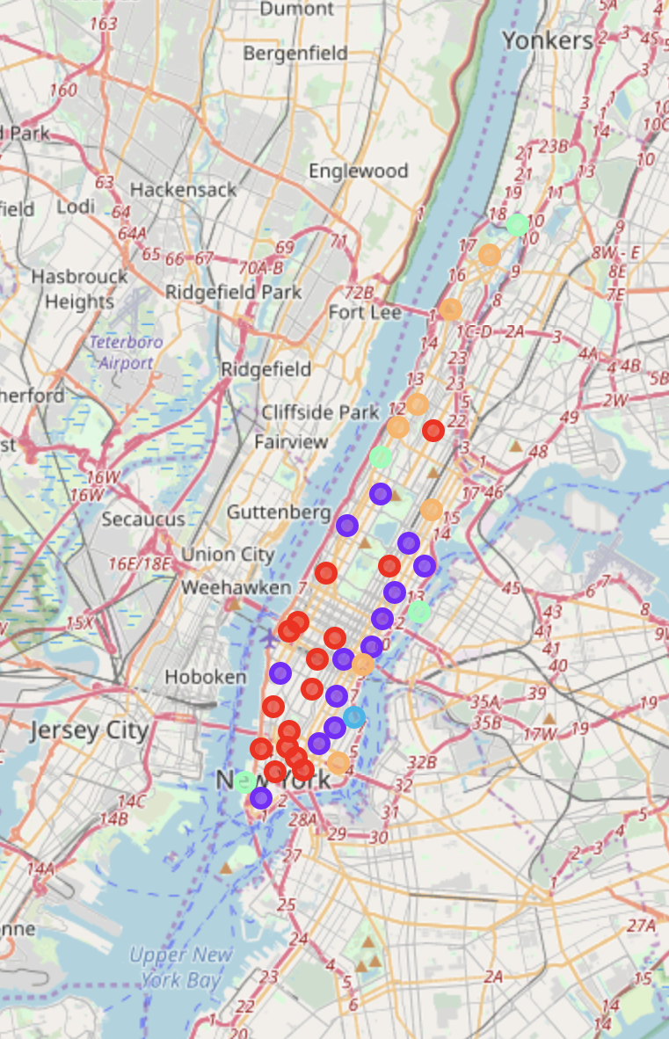
Manhattan neighborhoods and clusters
Neighborhood Map
Clustered neighborhood
Cluster 0
Cluster 1
Cluster 2
Cluster 3
Cluster 4

Slide 5
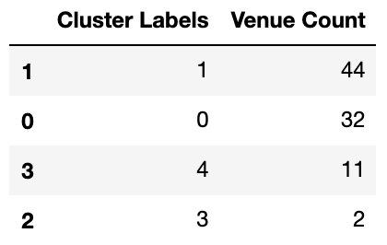
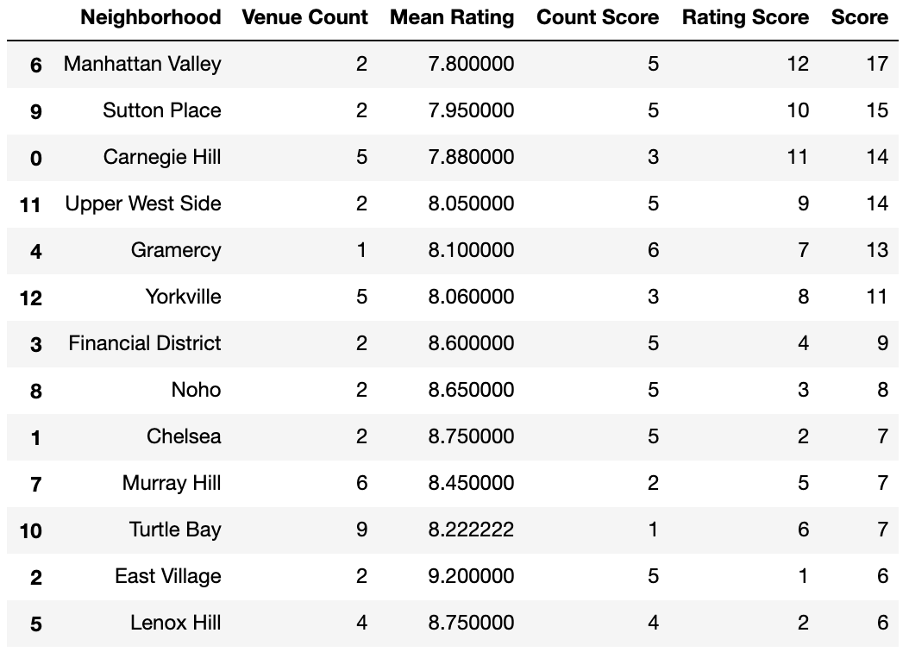
Result
Fig 1. Cluster 1 has the most Japanese Restaurant opened
Fig 2. Manhattan Valley has the combine the highest score (Low count and low rating)

Slide 6
Discussion and result
More parameters, including median or mean income, median or mean rental price, and distribution of ethnicities could be considered
Alternative accurate statistic tools could be used to validate
The rent is relatively low and young people take a large percentage of population
Take strategy of offering a broader and more economical menu

